Slide 1
CELL STRUCTURE
BMLT 117
MICROSCOPY
DR. KENNEDY GYAU BOAHEN (PHD).

Slide 2
UNITS OF MEASUREMENTS OF CELLS IN MICROSCOPY.
1000 microns or micrometers (µm)= 1mm
1000 mµ or nanometers (nm) = 1µm
10 Angstrom (Ǻ) = 1mµ
Microorganisms and their components are measured in small units such as micrometres and nanometers.
A micrometre (µm) is equal to 0.000001 m (10-6 m). A nanometer (nm) is equal to 0.000000001 m (10-9 m). Angstrom (Ǻ) was previously used for 10-10 m or 0.1 nm.

Slide 3
MICROSCOPY
The unaided human eye can distinguish objects as small as 0.1 mm (100µm), but not smaller than this.
To be able to view cell structure down to the molecular level while counteracting the transparency of the cell by increasing contrast requires the invention of microscopes with high resolving power.
TYPES OF LIGHT MICROSCOPE
There are two types of light microscopes:
Simple microscopes
Compound microscopes

Slide 4
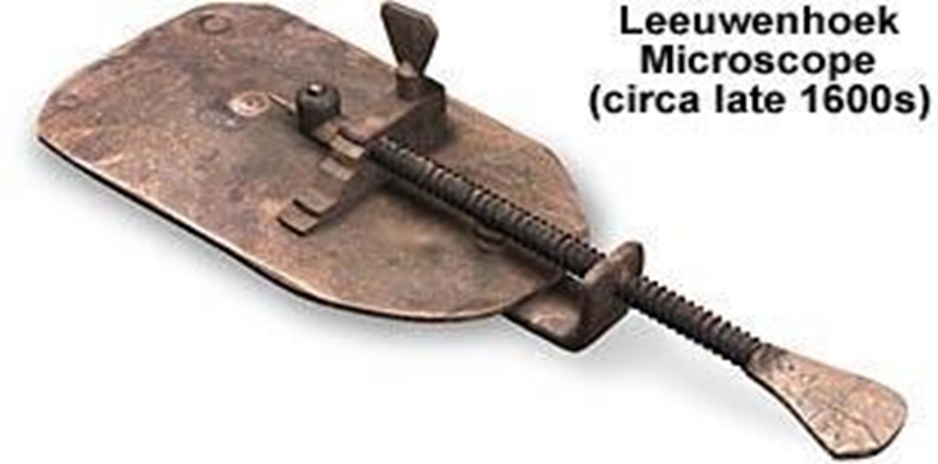
SIMPLE MICROSCOPE

Slide 5
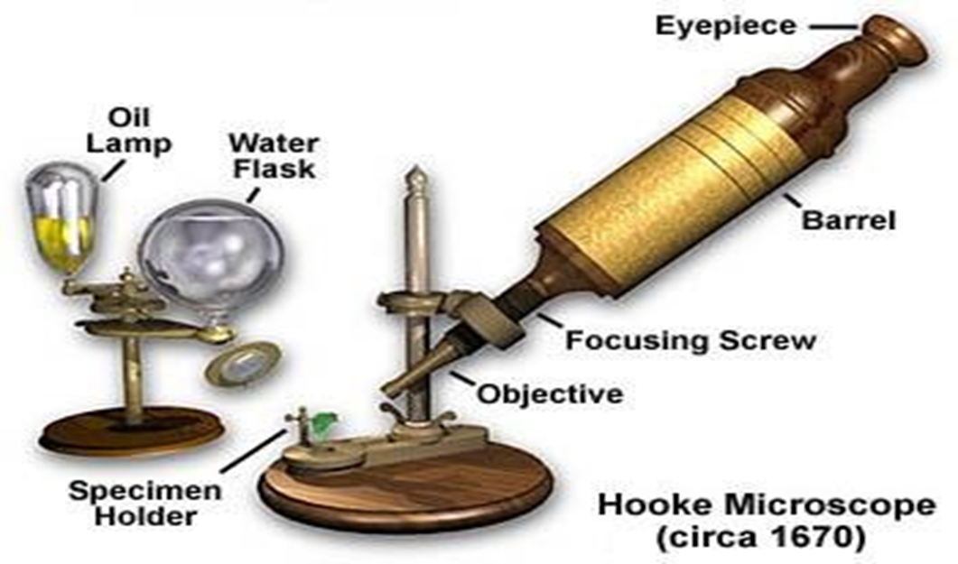
SIMPLE MICROSCOPE CONT’D

Slide 6
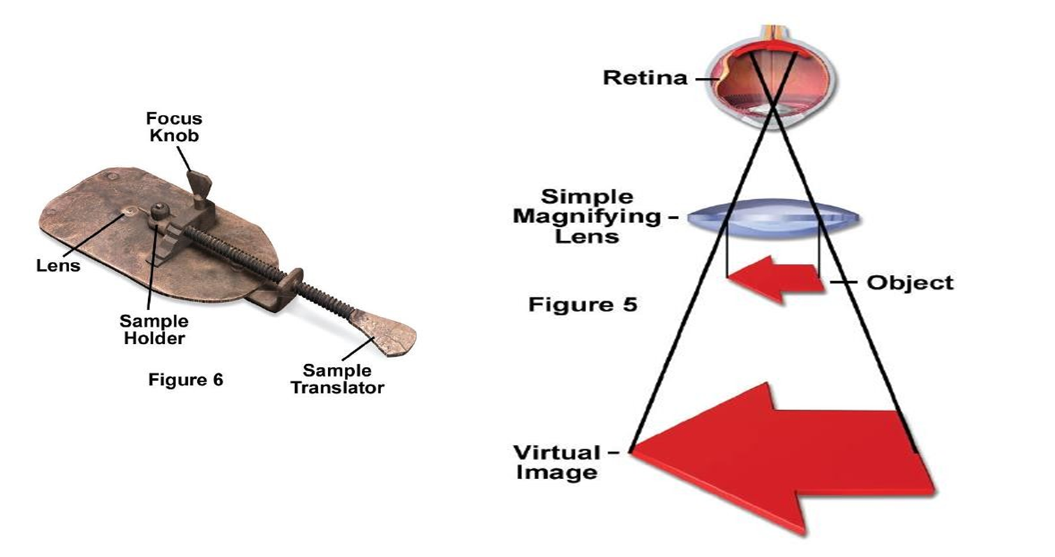
SIMPLE MAGNIFIER-FORMING AN IMAGE

Slide 7
SIMPLE MICROSCOPES
A simple microscope is a microscope which only has one lens.
Magnifying glasses and loupes are two well-known examples of the simple microscope.
Modern simple microscopes are usually hand held, designed for field work or quick viewing of objects which require magnification.

Slide 8
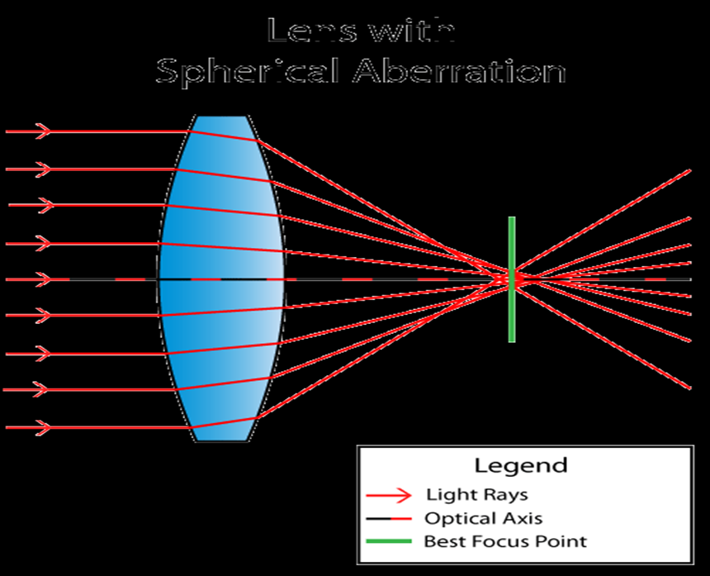
DEFECTS OF SIMPLE MICROSCOPES
There are two inherent optical defects associated with simple microscopes:
a) Spherical aberration: Blurred images are formed because light rays from a specimen are not brought to simultaneous focus.

Slide 9
DEFECTS OF SIMPLE MICROSCOPES
Spherical Aberration is an optical problem that occurs when all incoming light rays end up focusing at different points after passing through a spherical surface.
Light rays passing through a lens near its horizontal axis are refracted less than rays closer to the edge or “periphery” of the lens and as a result, end up in different spots across the optical axis.
In other words, the parallel light rays of incoming light do not converge at the same point after passing through the lens.
Because of this, Spherical Aberration can affect resolution and clarity, making it hard to obtain sharp images.
Notes:
Spherical aberration also occurs when the specimen and the objective lens are separated by several materials of different refractive indices e.g. air, glass etc. This results in the repeated bending of the light rays at different angles

Slide 10
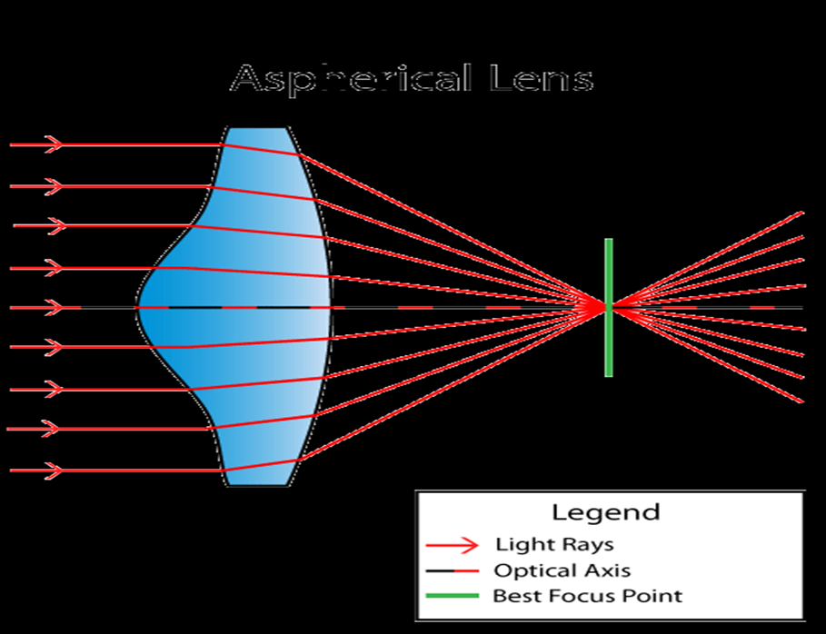
WAYS TO REDUCE SPHERICAL ABERRATION
Modern lenses employ different techniques to dramatically reduce spherical aberration. One of the methods employs using a specialized aspherical (meaning non- spherical) lens surface, which is curved outwards on one side for the sole purpose of converging light rays into a single focal point.

Slide 11
WAYS TO REDUCE SPHERICAL ABERRATION
Using oil immersion lens since this will fill the entire space between the specimen and the lens with substances of the same refractive index to eliminate spherical aberration
Using spherical lenses such as plano- convex lenses
This can be corrected by coating the periphery of the lens with opaque materials

Slide 12
DEFECTS OF SIMPLE MICROSCOPE
b) Chromatic aberration
Chromatic Aberration, also known as “colour fringing” or “purple fringing”, is a common optical problem that occurs when a lens is either unable to bring all wavelengths of colour to the same focal plane, and/or when wavelengths of colour are focused at different positions in the focal plane.
Chromatic aberration is caused by lens dispersion, with different colours of light travelling at different speeds while passing through a lens. As a result, the image can look blurred or noticeable coloured edges (red, green, blue, yellow, purple, magenta) can appear around objects, especially in high- contrast situations.

Slide 13
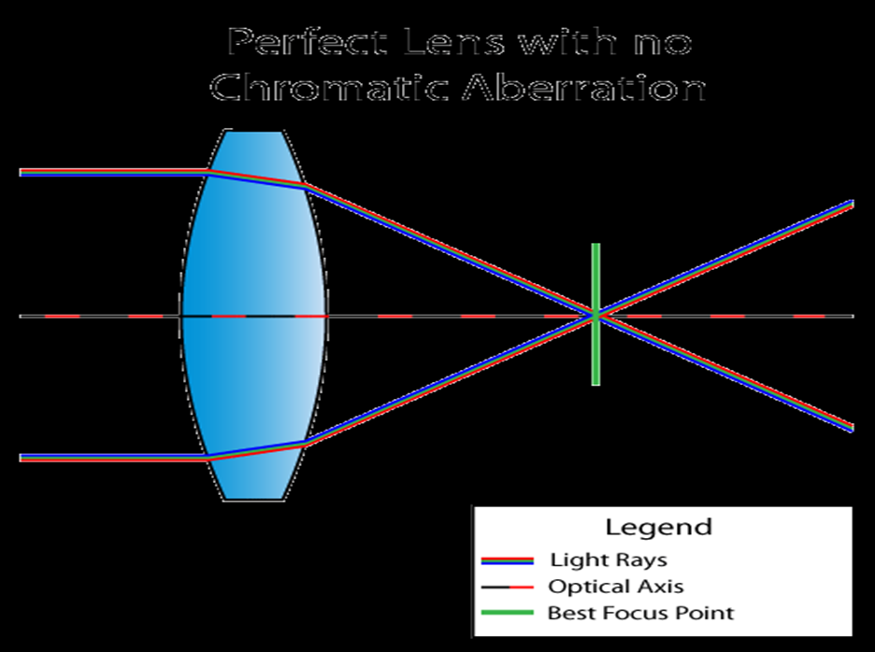
CHROMATIC ABERRATION CONT’D

Slide 14
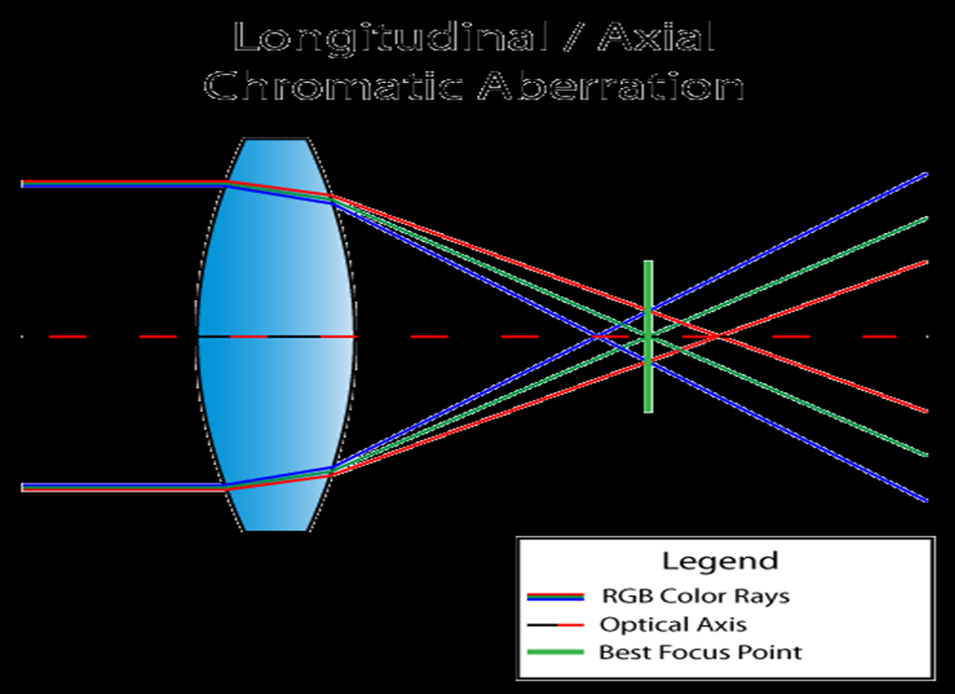
CHROMATIC ABERRATION CONT’D

Slide 15
WAYS OF CORRECTING CHROMATIC ABERRATION
Using flint glass and crown which have equal but opposite focal lengths. This combination of crown and flint is known as Acromatic Doublet.
Using more complex systems of lenses.

Slide 16
LIGHT MICROSCOPY
Light microscopy refers to the use of any kind of microscope that uses visible light to observe specimens. Here we examine several types of light microscopy.
The curvatures of the lens materials and their composition are designed to minimize distortion of image shapes and colors.
Light microscopes are of two different basic types:
Compound Microscopes: A modern compound light microscope has a series of lenses and uses visible light as its source of illumination. These microscopes require that the specimen to be examined, is cut/sliced thinly enough to allow light to pass through it.

Slide 17
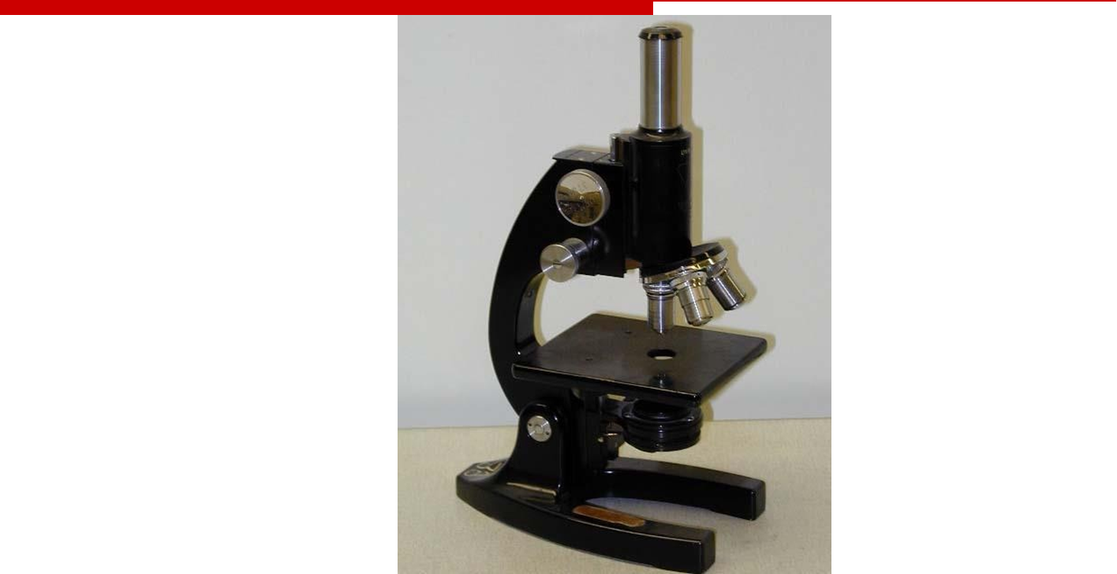
TYPES OF LIGHT MICROSCOPE
Dissecting Microscopes: These microscopes permit opaque specimens to be viewed.
MONOCULAR COMPOUND MICROSCOPE

Slide 18
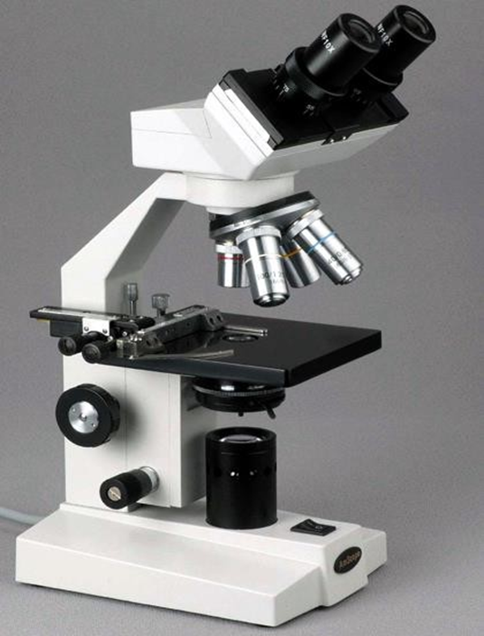
BINOCULAR COMPOUND MICROSCOPE

Slide 19
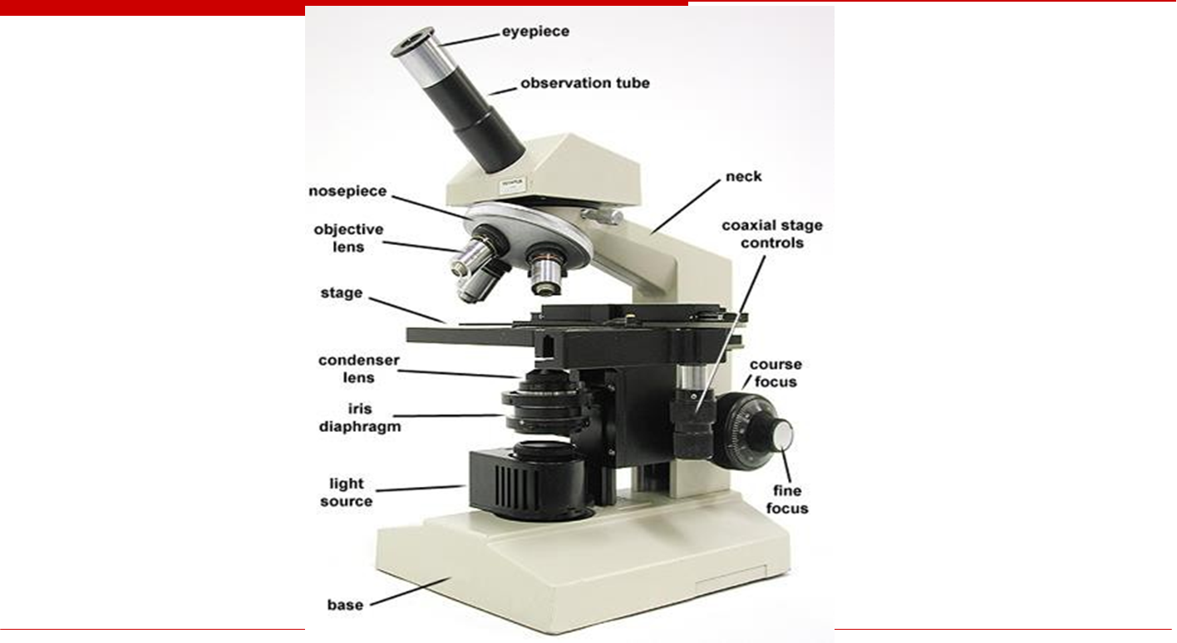
COMPOUND MICROSCOPE

Slide 20
FUNCTIONS OF MICROSCOPE
Microscopy serves two independent functions of enlargement (magnification) and improved resolution (the rendering of two objects as separate entities).

Slide 21
MAGNIFICATION OF LIGHT MICROSCOPES
In their most basic essentials, all microscopes aim at:
Magnifying the specimen and Displaying the specimen in greater details.
These aims are interdependent and it is important to realize that to increase magnification without a commensurate improvement in the degree of discernible detail is of little advantage.
a)Magnification: The magnification of any optical system is dependent upon the focal length of the lenses in the system and their mutual arrangement.

Slide 22
NAGNIFICATION OF LIGHT MICROSCOPE CONT’D
It is usually expressed as the ratio of the length of the final image to that of the specimen, and for the ordinary class microscope it is between 25x and 1500x. Some compound microscopes can achieve a useful magnification of 2000x with the oil immersion lens. Most dissecting microscopes magnify up to 30x.
Magnifications of more than 2000x for compound microscopes however, is considered “empty” because resolution does not improve with magnification beyond a certain point.

Slide 23
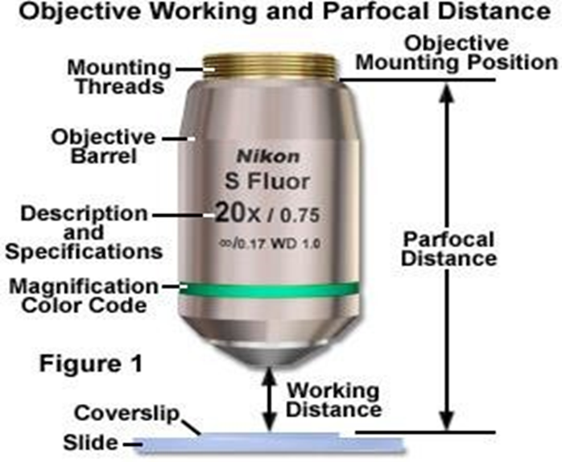
PARFOCAL
Parfocal microscope objectives stay in focus when magnification is changed; i.e., if the microscope is switched from a lower power objective (e.g., 10×) to a higher power objective (e.g., 40×), the object stays in focus.
OBJECTIVE WORKING AND PARFOCAL DISTANCE

Slide 24
OBJECTIVE WORKING AND PARFOCAL DISTANCE CONT’D
Working distance is the distance between the objective lens and the specimen. At low magnification the working distance is relatively long. As you increase the magnification the working distance decreases considerably.
Oil immersion lenses practically touch the specimen. Be aware of this change in working distance with increasing magnification so as to prevent damage to your specimens and the lens in particular.

Slide 25
RELATIONSHIP BETWEEN WORKING DISTANCE AND MAGNIFICATION
Generally speaking, the working distance of any given microscope is reduced as magnification increases. As in most compound microscopes, the lens is moved physically closer to the specimen to increase magnification; the working distance available between the lens and the specimen is reduced considerably as magnification increases.

Slide 26
RESOLUTION OF LIGHT MICROSCOPES
b) Resolution: The resolving power of a lens indicates the fineness of detail that it allows to be seen.
When examining two small specimens with a microscope lens, provided the specimens are well separated, they will be resolved as separate entities.

Slide 27
FACTORS THAT DETERMINE RESOLUTION
Numerical aperture: When light rays pass through a specimen containing fine detail they interfere with each other and they are variously diffracted; increasingly fine detail increases their angles of diffraction. Since the resolving power of a lens depends upon its ability to collect these diffracted rays, the wider the angle of rays collected, the better is the resolution.
The capacity of a lens to collect rays emerging from a specimen is defined by its numerical aperture (NA), and this depends upon both its angular aperture (U) and the refractive index (η) of the medium through which the rays pass. The relationship is expressed as: NA = η sin U

Slide 28
FACTORS THAT DETERMINE RESOLUTION CONT’D
The NA and resolution, is at their best when the cone of rays emerging from the specimen just fills the angular aperture.
In the conventional light microscope, the medium between the low power (less than x100) objective lenses and the specimen is air (i.e. the refractive index, η = 1).
For higher resolution power, the refractive index may be increased by filling this space with a special “immersion” oil. (The refractive index of the immersion oils + glass = 1.55).
This arrangement increases the NA and results in fewer light rays being lost due to refraction. Resolution is thus improved.

Slide 29
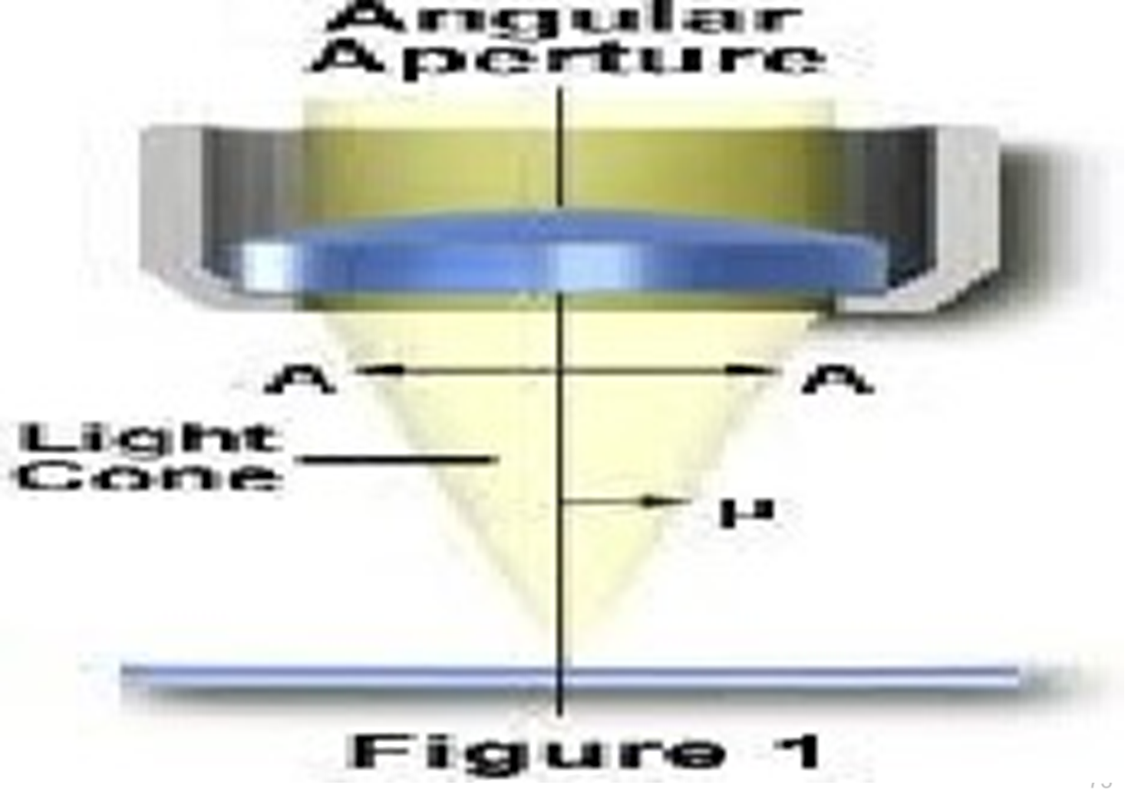
FACTORS THAT DETERMINE RESOLUTION CONT’D

Slide 30
FACTORS THAT DETERMINE RESOLUTION CONT’D
Wavelength: Resolution also depends upon the wavelength of the transmitted wave form; the smaller the wavelength the better is the resolution.
Limit of resolution (r): Resolution is the ability of a lens to separate or distinguish between small objects that are close together.
Regarding the numerical aperture (NA) and wavelength (λ), it is expressed as: r = 0.61 λ /NA In practice, the maximum NA available for light microscope objective lenses is about 1.4.

Slide 31
BRIGHT-FIELD MICROSCOPY
Bright field microscope relies upon light from the lamp source being gathered by the sub-stage condenser and shaped into a cone whose apex is focused at the plane of the specimen.
This ability is dependent upon the refractive index and the opacity of the specimen.
To see a specimen in a bright field microscope, the light rays passing through it must be changed sufficiently to be able to interfere with each other which produces contrast (differences in light intensities).
Specimen must have this inherent contrast caused by the proper refractive indices or be artificially stained. These limitations require instructors to find naturally high-contrast materials or to enhance contrast by staining them which often requires killing them

Slide 32
DARKFIELD MICROSCOPY
The structure of many biological specimens are of low contrast that cannot be revealed by the bright field compound microscopes.
Microscopes that improve the contrast of these specimens through special optics are prohibitively expensive.
Dark field microscopy is a very simple yet effective technique and well suited for uses involving live and unstained biological samples, such as a smear from a tissue culture or individual water-borne single-celled organisms.
Considering the simplicity of the setup, the quality of images obtained from this technique is impressive.

Slide 33
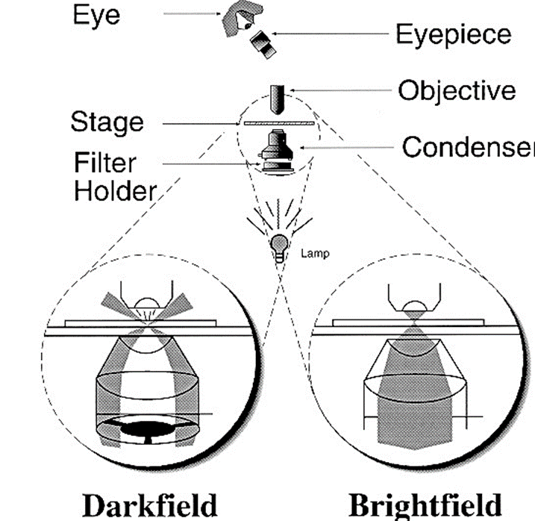
DARKFIELD AND BRIGHTFIELD COMPARED

Slide 34
PHASE-CONTRAST MICROSCOPY
Differences in light absorption are often negligible between living cells and their surrounding nutrient medium, as well as between the various intracellular components and plasma membranes, rendering these entities barely visible when observed by brightfield illumination.
When living cells are examined by normal light microscopy it is frequently difficult to see cell contents. This is because the human eye normally detects contrast by differences in colour or in intensity of illumination, and living cells are normally colourless and more or less transparent.
One common method of overcoming this difficulty is to stain cells with various dyes but, as this usually results in death or disruption, it cannot be used to examine living cells. One technique which is now widely used to solve this problem is known as phase contrast microscopy.

Slide 35
PHASE-CONTRAST MICROSCOPY CONT’D
The wavelength of light is a measure of colour whilst amplitude is a measure of brightness.
When a specimen is examined with a light microscope, the light passing through the specimen will be affected in two ways in relation to the light passing through the surroundings and will produce the contrast in the image.
Firstly, the light will be diffracted or scattered, and may be lost to the image; the greater the diffraction, the darker the image.
Secondly, the diffracted rays that do pass through the microscope will be retarded in relation to the light that did not pass through the specimen, the degree of retardation depends on the thickness of the specimen.
Thus two sets of rays will arrive at the eye, the diffracted and undiffracted. The slight phase change produced in the diffracted rays will interfere with the other rays Resulting in a net reduction in amplitude, and so a lowering of brightness.

Slide 36
PHASE-CONTRAST MICROSCOPY CONT’D
The image seen by the eye is, in fact a complex interference pattern of diffracted and undiffracted rays.
Normally the change in phase, and amplitude, is slight, and produces little contrast. The phase contrast microscope functions by further retarding the deffracted rays producing a greater change in amplitude on interference, and so a greater reduction in brightness.
In the phase contrast microscope the light rays from the specimen background pass through the thinner portion of the positive phase plate and those that pass through the specimen will pass through the thicker portion of the positive phase plate and so suffer a greater diffraction (retardation), enhancing the phase difference produced by passage through the specimen.

Slide 37
PHASE-CONTRAST MICROSCOPY CONT’D
In addition, further light will be lost by the greater scatter produced by the thicker part of the positive phase plate, and so contrast will be enhanced by both greater amplitude changes and loss of light.
Phase contrast microscopy is now widely used to study living cells and tissues. Considerable cytological detail of cell movement, changes in nuclei and other organelles, and cytoplasmic flow have been observed although resolution is still limited by the wavelength of visible light. Phase contrast microscopy has been particularly useful when used in conjunction with time-lapse motion photography of living cells.

Slide 38
PHASE-CONTRAST MICROSCOPY CONT’D
PRINCIPLE
Light rays passing through a transparent specimen emerge as either direct rays or diffracted rays.
In phase microscopy, this effect is amplified by using a microscope equipped with special annulus ( below the stage) and phase plates (located in the objectives) which accentuate the phase changes produced by the specimen.
Direct rays, unimpeded by the phase plate (blue rays) are of higher intensity, making the background bright and the diffracted rays (red rays) impede by the phase plate are of lower intensity, making parts of the specimen darker.

Slide 39
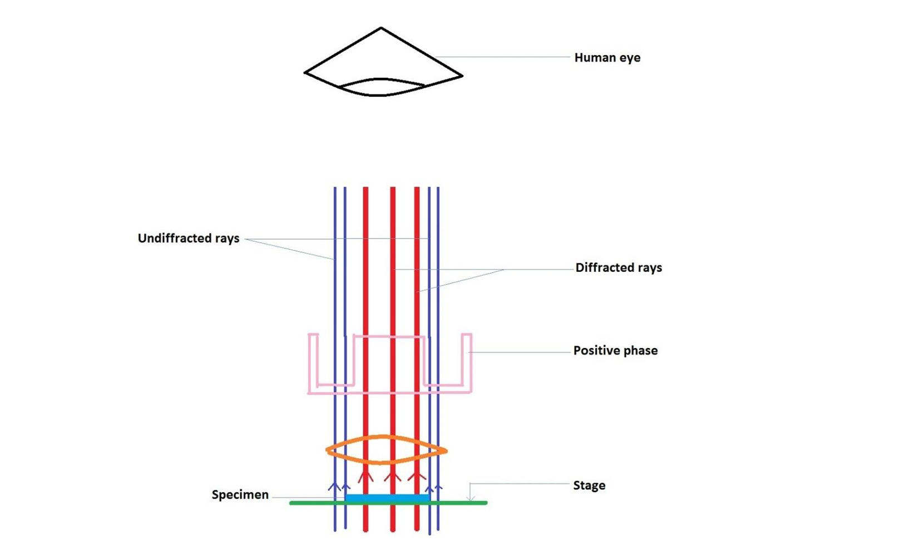
PHASE-CONTRAST MICROSCOPY CONT’D

Slide 40
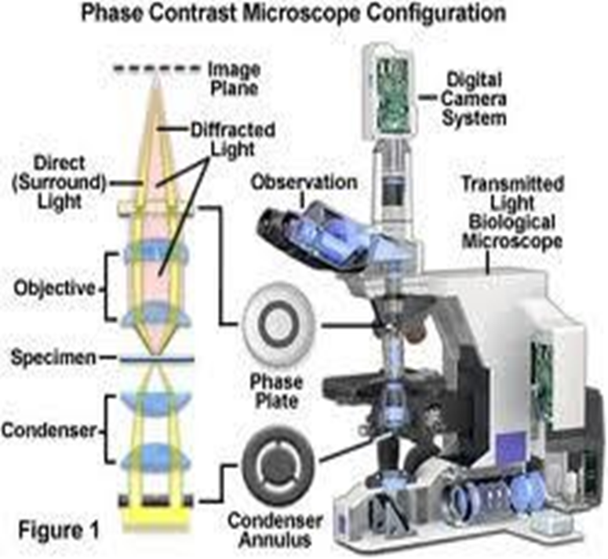
PHASE-CONTRAST MICROSCOPE

Slide 41
ULTRA VIOLET MICROSCOPY
This type of microscope uses U/V light that tends to increase resolution two-fold compared with a microscope that uses white light.
This type of microscope makes use of specimens that either have the natural ability to absorb U/V light and re-emit it as the light of longer wavelength or are stained with specific dyes to aid them absorb U/V light and re-emit it as the light of longer wavelength visible to the human eye.
The main disadvantages of using this microscope are:
U/V cannot pass through glass lenses and hence the lenses have to be replaced with quartz lenses which are expensive.
The U/V light carrying the image of the specimen is not visible to the human eye.

Slide 42
ULTRA VIOLET MICROSCOPY CONT’D
U/V light has the tendency to damage the eye and requires that the microscope be fitted with a camera or the image of the specimen projected onto a fluorescent screen.

Slide 43
What is a Fluorescence Microscope?
Basic Requirements of Fluorescence Microscope Optics.
the objective lens performs two functions:
1. Focus the illumination (excitation) light on the sample. In order to excite fluorescent species in a sample, the optics of a fluorescent microscope must focus the illumination (excitation) light on the sample to a greater extent than is achieved using the simple condenser lens system found in the illumination light path of a conventional microscope.

Slide 44
2. Collect the emitted fluorescence. This type of excitation-emission configuration, in which both the excitation and emission light travel through the objective, is called epifluorescence.
The key to the optics in an epifluorescence microscope is the separation of the illumination (excitation) light from the fluorescence emission emanating from the sample.
In order to obtain either an image of the emission without excessive background illumination or a measurement of the fluorescence emission without background "noise", the optical elements used to separate these two light components must be very efficient.

Slide 45
The Dichroic Mirror
In a fluorescence microscope, a dichroic mirror is used to separate the excitation and emission light paths. Within the objective, the excitation/emission share the same optics.

Slide 46
FLUORESCENCE MICROSCOPY CONT’D
Cell structures containing the specific proteins capable of binding the fluorescein-labelled antibody are caused to fluoresce when examined with fluorescence microscope. This technique in microbiology is called immunofluorescence.
U/V – FLUORESCENCE MICROSCOPY
Fluorescence microscopy is used to detect structures, molecules or proteins within a cell. Fluorescent molecules absorb light at one wavelength and emit at another, longer wavelength. When fluorescent molecules absorb a specific absorption wavelength for an electron in a given orbital, the electron rises to a higher energy level.

Slide 47
U/V – FLUORESCENCE MICROSCOPY CONT’D
Electrons in this state are unstable and will return to the ground state, releasing energy in the form of light and heat. This emission of energy is fluorescence.
In fluorescence microscopy, a cell is stained with a dye and the dye is illuminated with filtered light at the absorbing wavelength; the light emitted from the dye is viewed through a filter that allows only the emitted wavelength to be seen.
The dye glows brightly against a dark background because only the emitted wavelength is allowed to reach the eyepieces or camera port of the microscope.

Slide 48
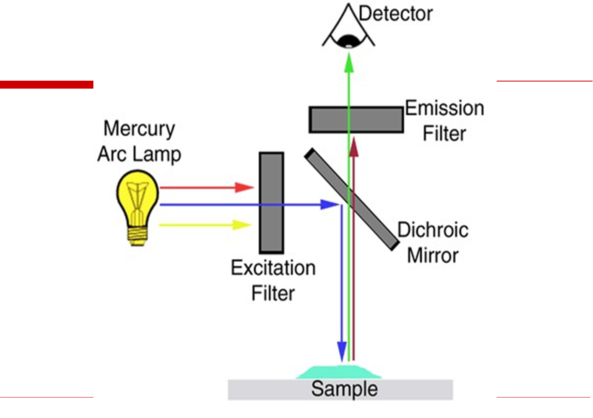
U/V – FLUORESCENCE MICROSCOPY CONT’D

Slide 49
ELECTRON MICROSCOPY CONT’D
There are two types of electron microscopes: The Transmission electron microscope (TEM) and the Scanning electron microscope (SEM).
Transmission electron microscope (TEM)
In transmission electron microscope, a finely focused beam of electrons from an electron gun passes through a specially prepared, ultrathin section of the specimen.
The ray of electrons is produced by a pin-shaped cathode heated up by current. The electrons are vacuumed up by a high voltage at the anode.
The acceleration voltage is between 50 and 150 kV. The higher it is, the shorter are the electron waves and the higher is the power of resolution. But this factor is hardly ever limiting.

Slide 50
Transmission electron microscope (TEM) cont’d
The power of resolution of electron microscopy is usually restrained by the quality of the lens- systems and especially by the technique with which the preparation has been achieved. Modern gadgets have powers of resolution that range from 0.2 – 0.3 nm.
The useful resolution is therefore around 300,000 x. The accelerated ray of electrons passes a drill hole at the bottom of the anode. It follows a way analogous to that of a ray of light in a light microscope.
The lens-systems consist of electronic coils generating an electromagnetic field. The ray is first focused by a condenser. It then passes through the object, where it is partially deflected. The degree of deflection depends on the electron density of the object.

Slide 51
Transmission electron microscope (TEM) cont’d
The greater the mass of the atoms, the greater the degree of deflection. Biological objects have only weak contrasts since they consist mainly of elements with low atomic numbers (C, H, N, O).
After passing through the object the scattered electrons are collected by an objective.
Thereby an image is formed, that is subsequently enlarged by an additional lens system (called projective with electron microscopes).
The thus formed image is made visible on a fluorescent screen or it is documented on photographic material.

Slide 52
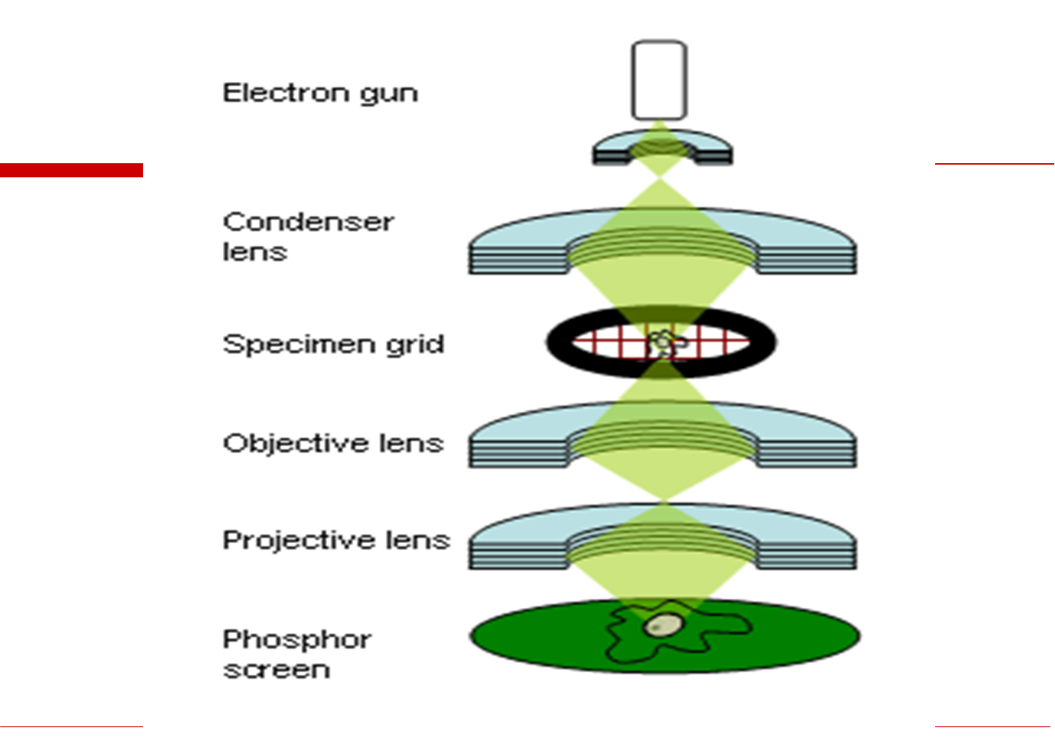
Transmission electron microscope (TEM) cont’d

Slide 53
SCANNING ELECTRON MICROSCOPY
The Scanning Electron Microscope (SEM) is a microscope that uses electrons rather than light to form an image. There are many advantages to using the SEM instead of a light microscope. The SEM has a large depth of field, which allows a large amount of the sample to be in focus at one time.
The SEM also produces images of high resolution, which means that closely spaced features can be examined at a high magnification. The combination of higher magnification, larger depth of focus, greater resolution, and ease of sample observation makes the SEM one of the most heavily used instruments in research areas today.

Slide 54
SCANNING ELECTRON MICROSCOPY CONT’D
A scanning electron microscope (SEM) is a powerful microscope that uses electrons rather than light to form an image of objects such as fractured metal components, foreign particles and residues, polymers, electronic components, biological samples, and countless others.
The shorter wavelength of electrons permits image magnifications of up to 100,000X, as compared to about 2,000X for conventional light microscopy. An SEM also provides a greater depth of field than a light microscope, allowing complex, three-dimensional objects to remain sharp and in focus. This capability reveals details that cannot be resolved by light microscopy.

Slide 55
SCANNING ELECTRON MICROSCOPY CONT’D
SEM is used to look at the surface of a solid specimen. The resolution is usually only 10 nm (unless FESEM is used), but with 20 000× magnification. We get very attractive 3D- looking images because of the large depth of field.

Slide 56
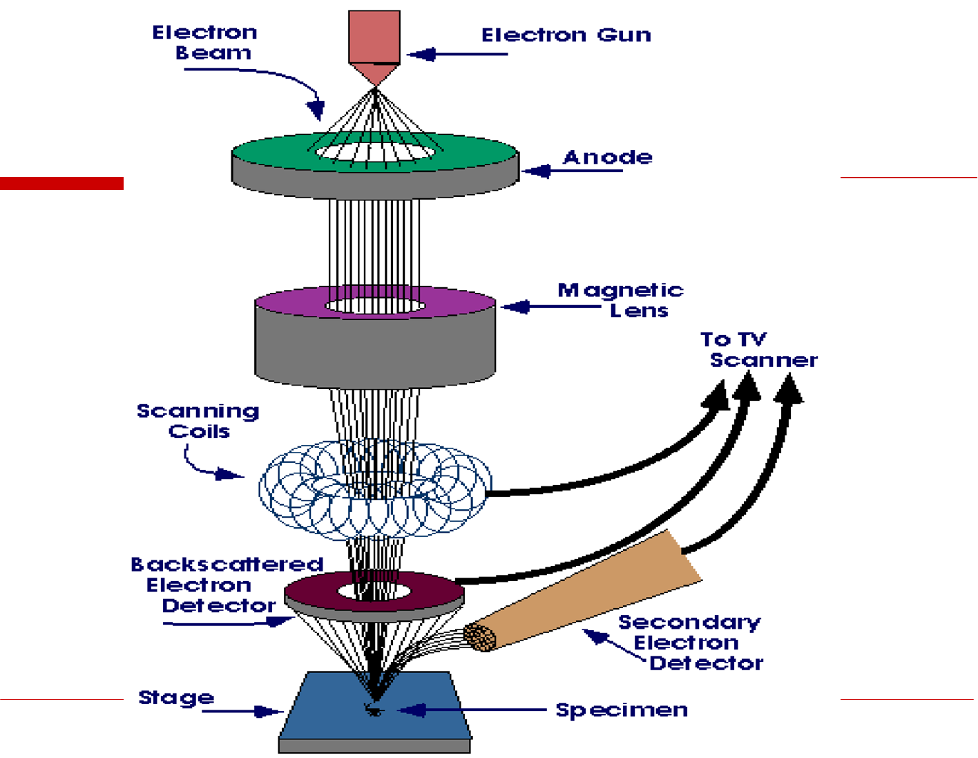
SCANNING ELECTRON MICROSCOPY CONT’D

Slide 57
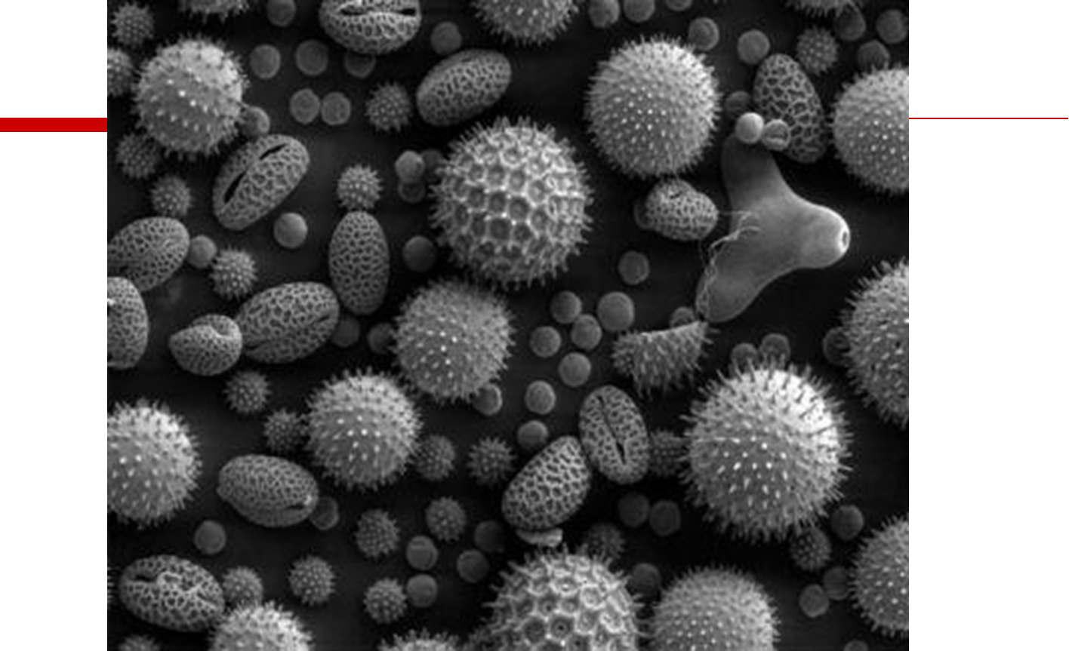
Scanning electron microscope image of pollen

Slide 58
THANK YOU

